Slide 1

Introduction to IoT
Pavel Genevski, Researcher / Architect @ SAP Labs Bulgaria February, 2018

Slide 2
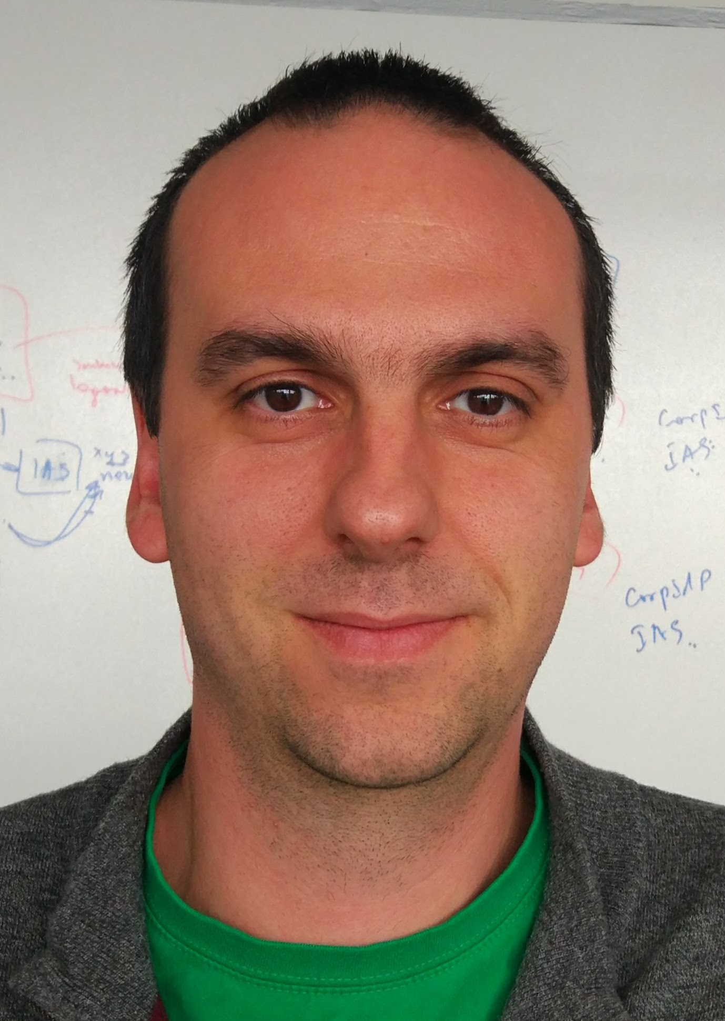
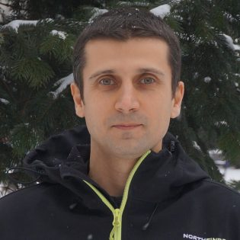

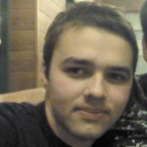
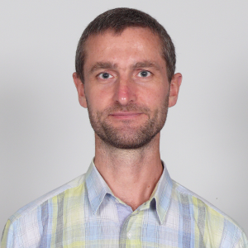
Teachers
SAP Labs
Pavel Genevski
Vladimir Savchenko
Hristo Kirilov
Vladimir Nachev
FMI
Trayan Iliev

Slide 3
Administrative Q&A
Кога?
Четвъртък от 17:00 до 21:00
Къде?
Зала 320
Как да минем?
Защита на групов проект + quizzes / индивидуални впечатления

Slide 4
Let’s get started!

Slide 5
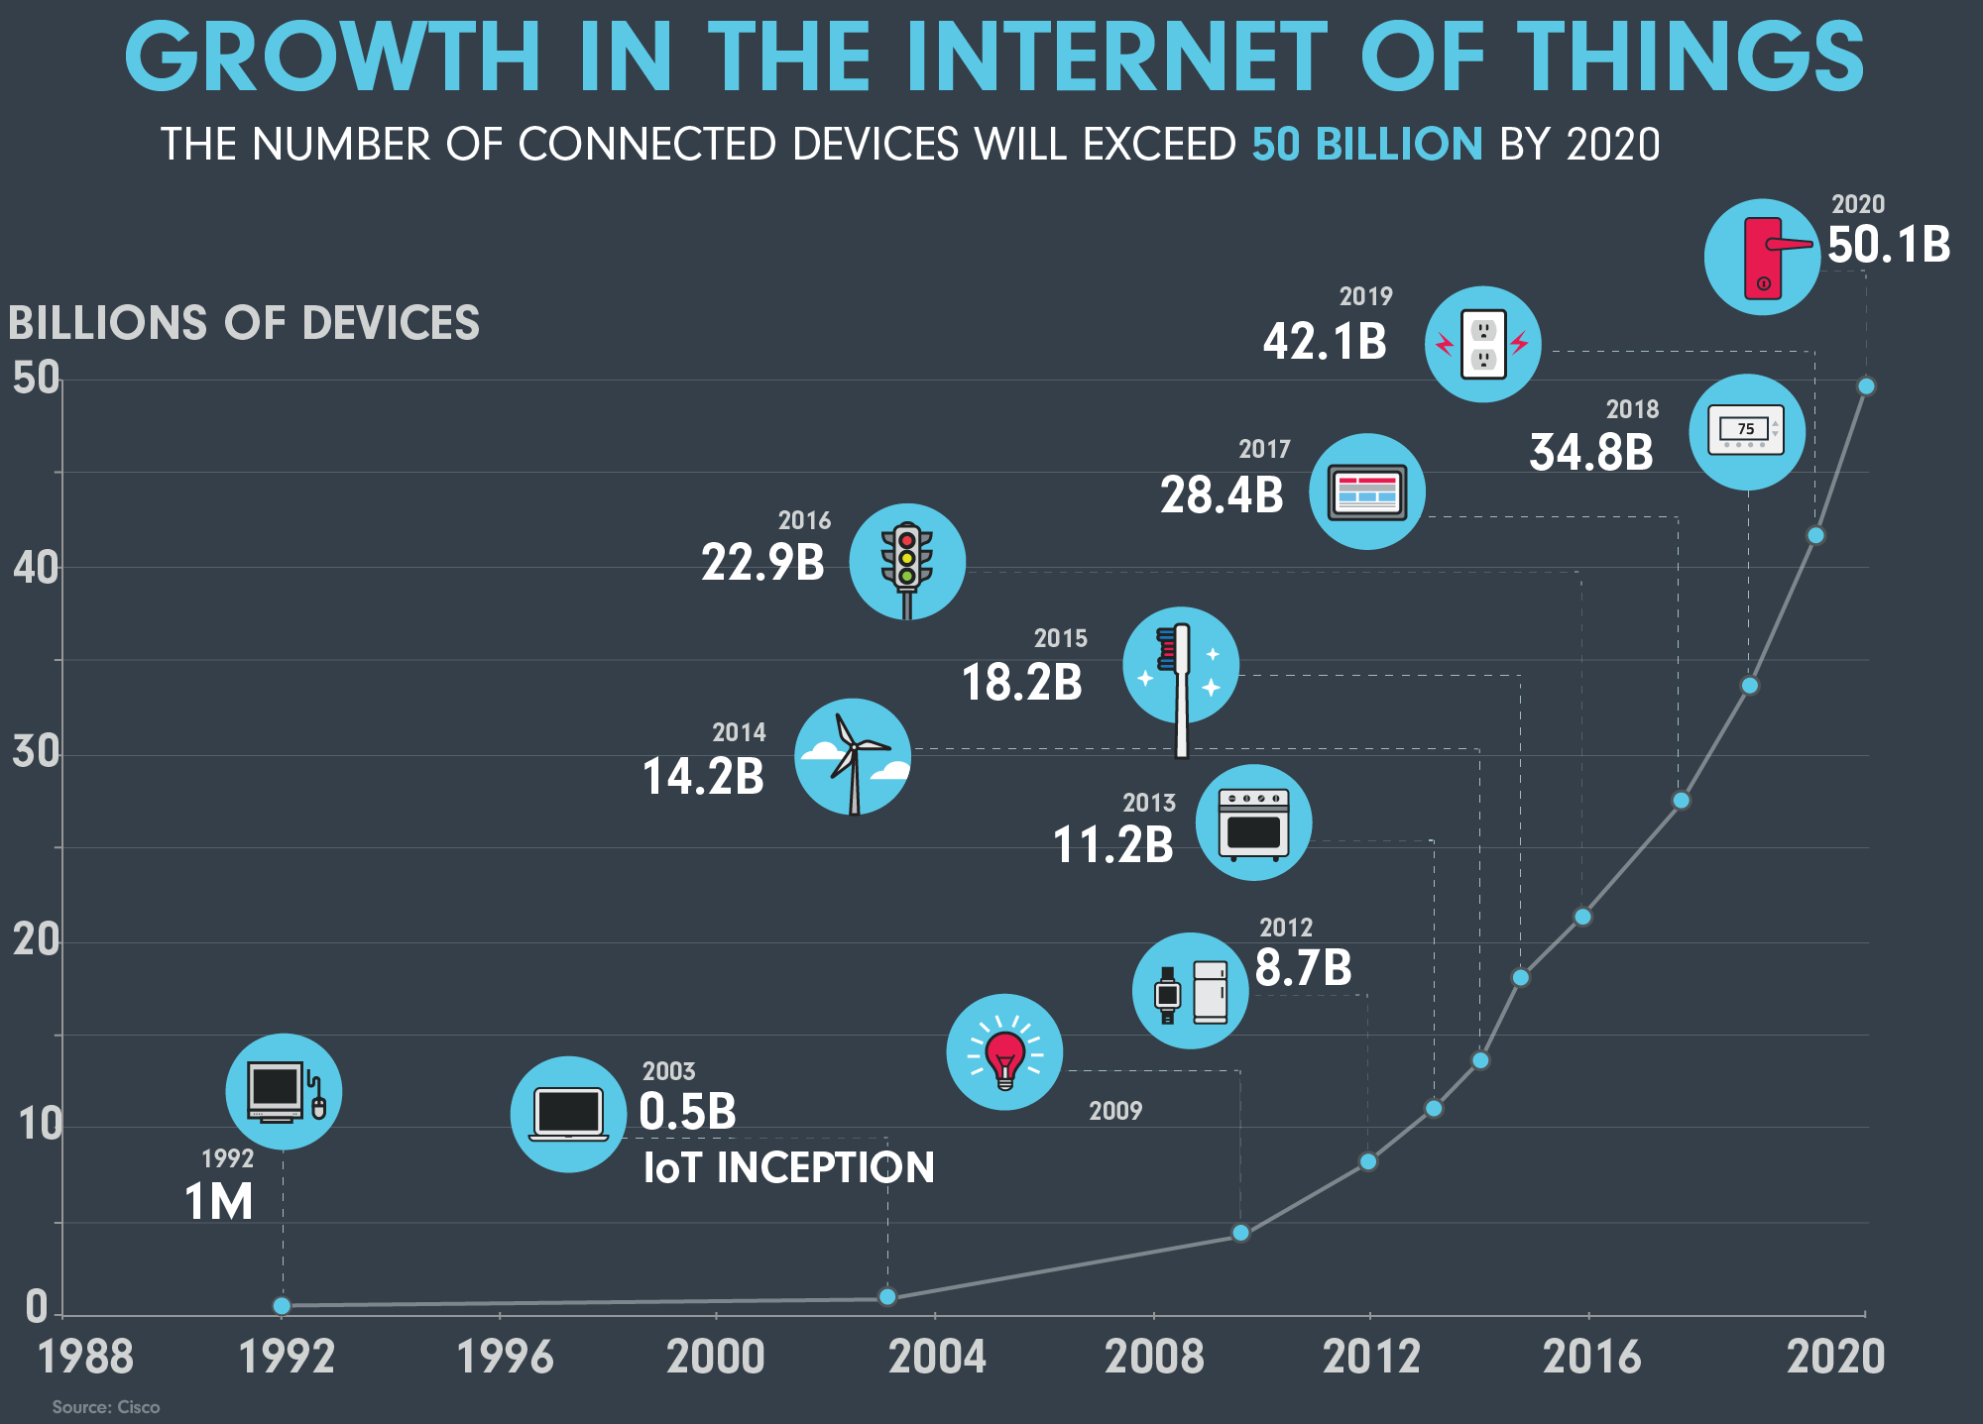
Over 20 billion connected devices
Consumer market: ~$546B
1.4B smartphones (flat*)
157M tablets (7% decline)
21M smartwatches (flat*)
Industrial market: ~$868B
Factories (Industry 4.0)
Logistics
Meters
Trains
Cities
….
Source: https://www.ncta.com/sites/prod/files/GROWTH_IOT-091516-IF-2000w.png
Notes:
https://www.ncta.com/sites/prod/files/GROWTH_IOT-091516-IF-2000w.png
http://www.scmp.com/tech/article/2067481/smartwatch-market-hits-record-211-million-sales-2016-apple-pulls-ahead-Samsung (Garmin 360% up)
http://www.pcworld.com/article/3167268/internet-of-things/as-iot-sales-surge-consumers-still-lead-the-way.html
http://www.sap.com/bulgaria/solution/internet-of-things.html
http://www.forbes.com/sites/louiscolumbus/2016/11/27/roundup-of-internet-of-things-forecasts-and-market-estimates-2016/#52248474ba55

Slide 6
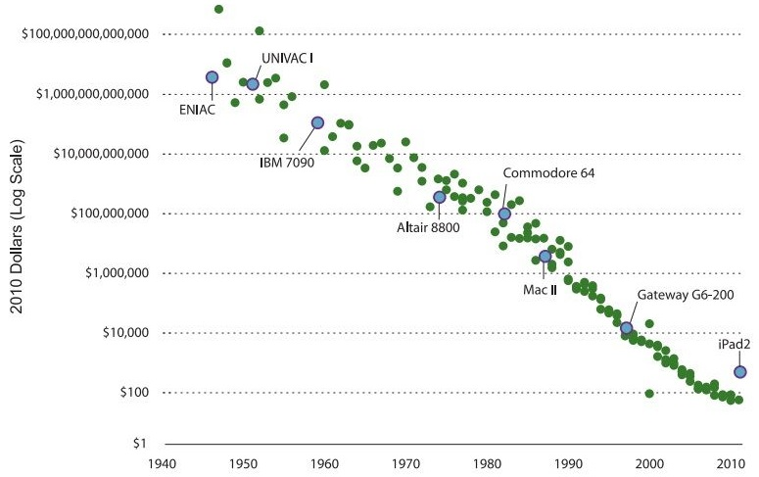
How did we get here?
Hardware is now …
Cheaper
Smaller
More connected
Less power hungry
Easier to develop
Ecosystem
More knowledge
More opportunities
More investment
Source: http://www.hamiltonproject.org/ee-ce-image/made/assets/img/uploads/charts/cost_of_computing_power_equal_to_an_ipad2_1017_685_80.jpg
Notes:
http://www.hamiltonproject.org/ee-ce-image/made/assets/img/uploads/charts/cost_of_computing_power_equal_to_an_ipad2_1017_685_80.jpg

Slide 7
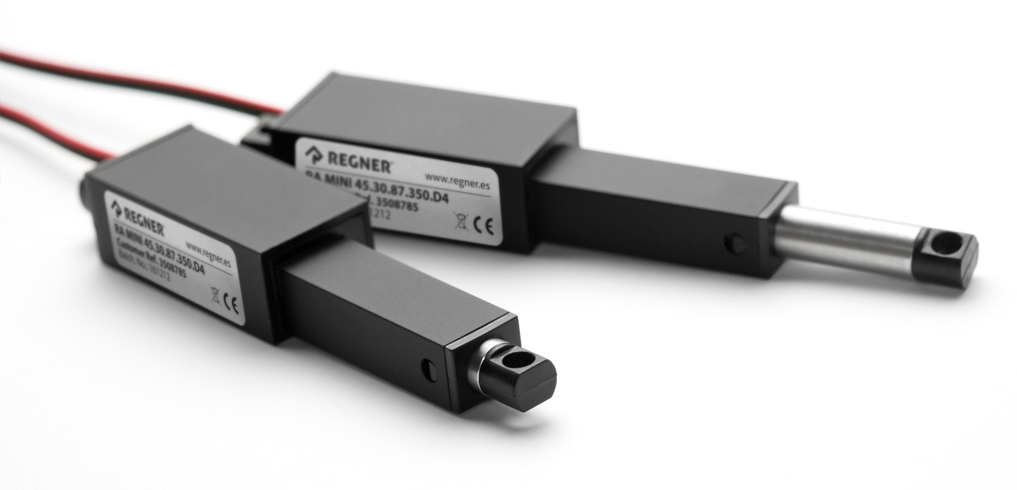
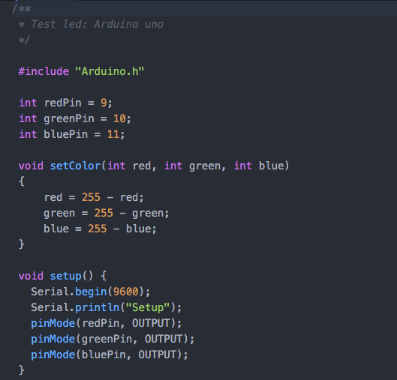
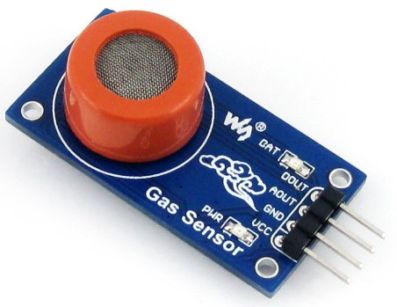

What is IoT?
Physical
Sensors, Actuators
Connected
WiFi, Bluetooth, Cellular, LPWAN …
Programmable
Arduino, C/C++, Python, Java, Assembly ..
(Atmel, Espressif, TI, Microchip, MIPS, ARM …)

Slide 8

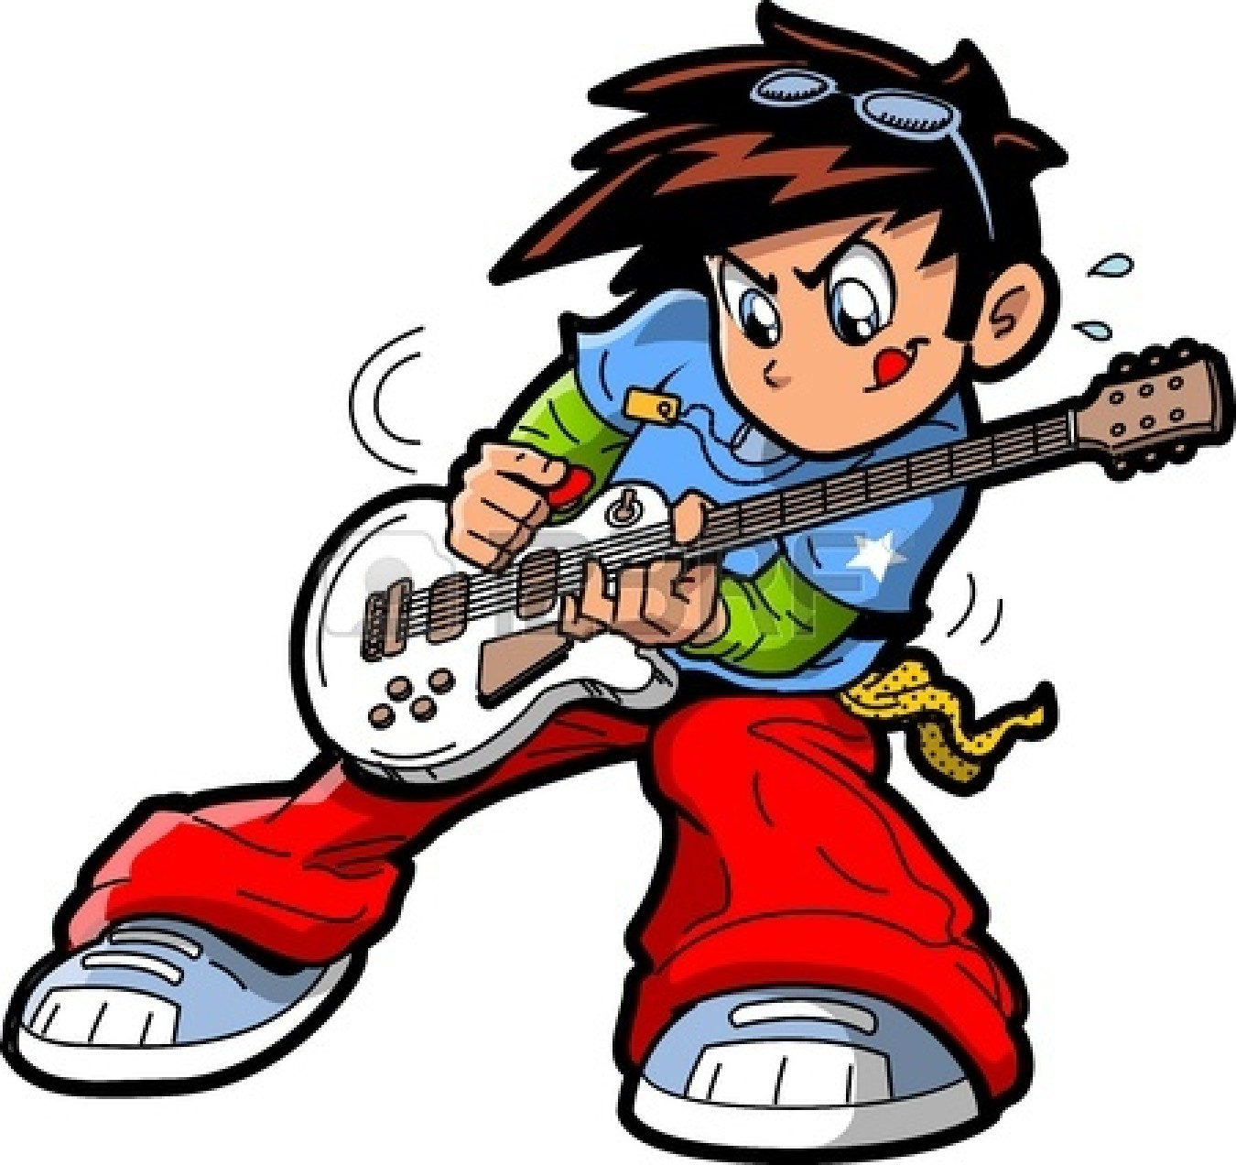
Industrial vs Consumer IoT
Industrial IoT
Drivers: cost and risk reduction, business agility, informed decision making
Challenges: security, compliance, compatibility, reliability, connectivity, support …
Consumer IoT
Drivers: coolness, convenience, health, some cost reduction
Challenges: UX, hype vs value, time to market, some privacy and security
Source:http://www.clipartpanda.com/clipart_images/stacks-of-money-clipart-1-57831954
Notes:
http://www.clipartpanda.com/clipart_images/stacks-of-money-clipart-1-57831954
http://www.clipartpanda.com/clipart_images/anime-manga-rock-star-guitar-38034053

Slide 9
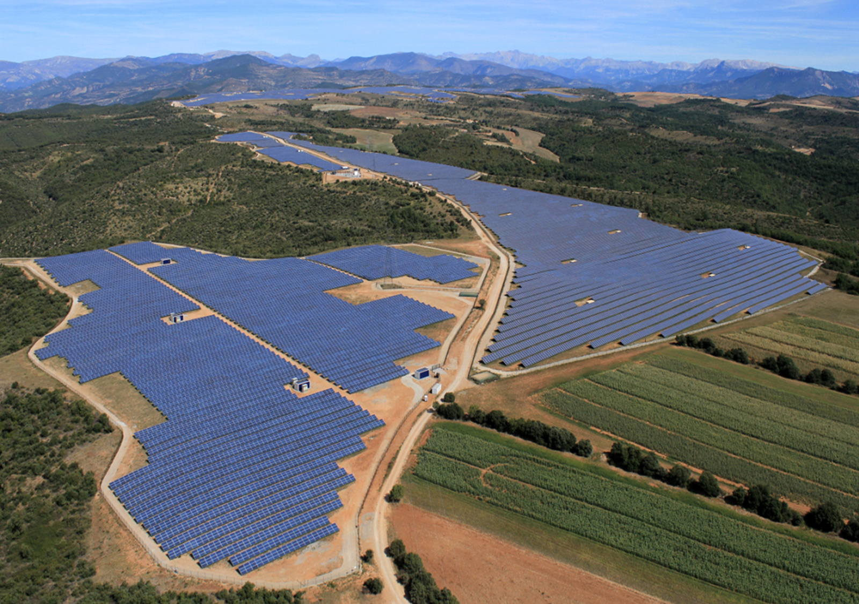
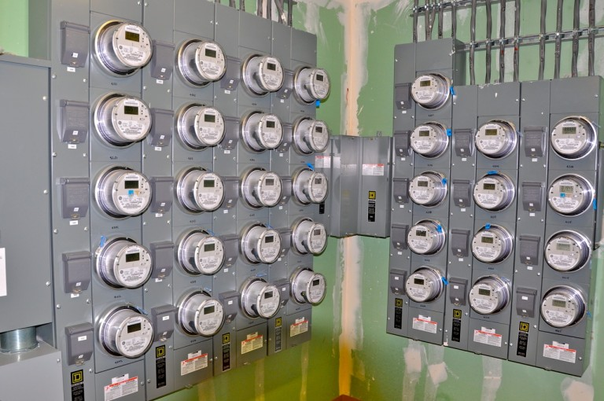
Industrial IoT examples
Predictive maintenance & Remote management
Solar & wind power, pipelines, bridges, facilities, vehicles, crops …
Smart utilities (meters)
Remote and continuous metering of water, electricity, gas …
Source: http://www.metering.com/wp-content/uploads/2016/05/smart-meters-768x510.jpg
Notes:
http://www.triplepundit.com/2016/04/beyond-energy-savings-smart-buildings-triple-threat-2/
http://www3.weforum.org/docs/WEFUSA_IndustrialInternet_Report2015.pdf
Drones are used for many monitoring tasks
There is an insurance use case for vehicle monitoring (both rent-a-car and cu
http://cdn.phys.org/newman/gfx/news/hires/2012/optimalplann.jpgstomer…). It is about differential pricing and disaster avoidance (e.g. in Australia)
http://www.metering.com/wp-content/uploads/2016/05/smart-meters-768x510.jpg

Slide 10
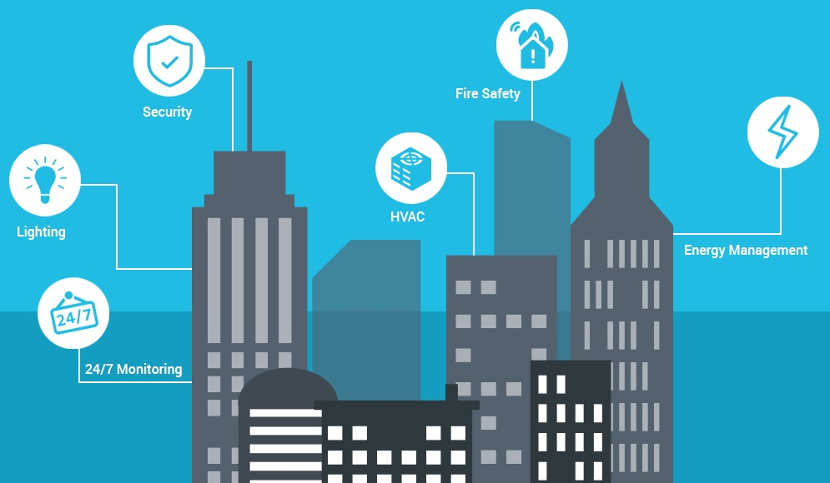
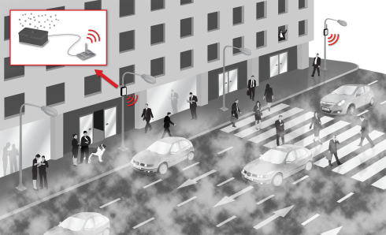
Industrial IoT examples contd.
Smart buildings
HVAC, lighting, security & access control, safety monitoring, indoor positioning …
Smart City
Pollution, traffic, controlling, services …
Source:http://blueapp.io/wp-content/uploads/2016/08/How-IoT-optimize-building-performance-with-in-minimal-operational-cost.jpg
Source: http://www.libelium.com/libelium-images/generico2/sensor_polvo-490.png
Notes:
http://www.libelium.com/libelium-images/generico2/sensor_polvo-490.png
http://blueapp.io/wp-content/uploads/2016/08/How-IoT-optimize-building-performance-with-in-minimal-operational-cost.jpg

Slide 11
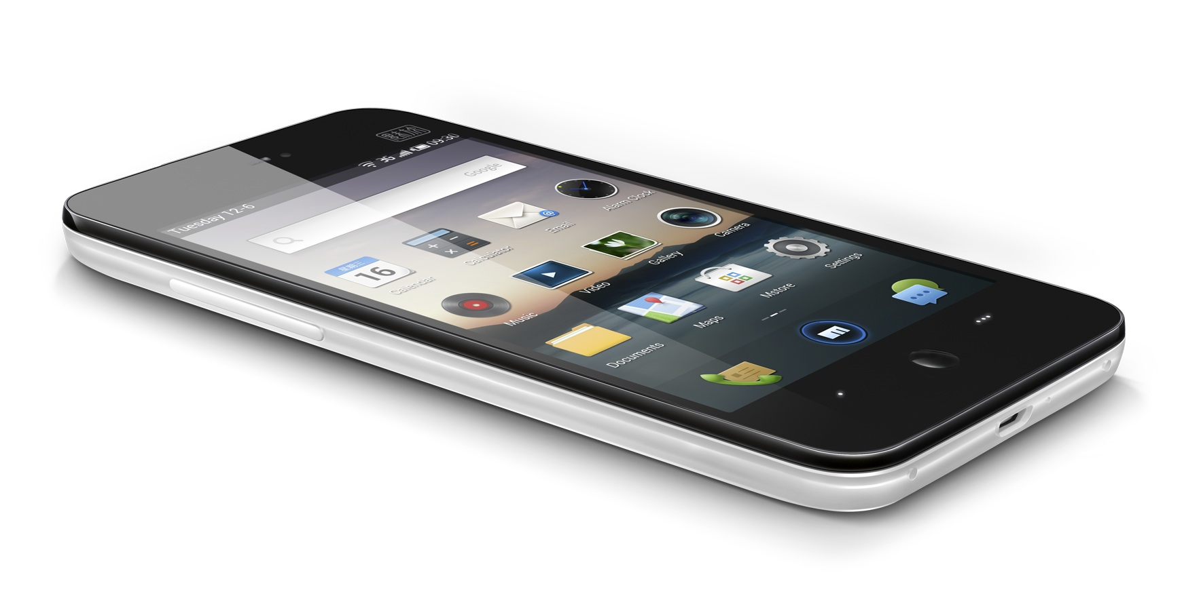
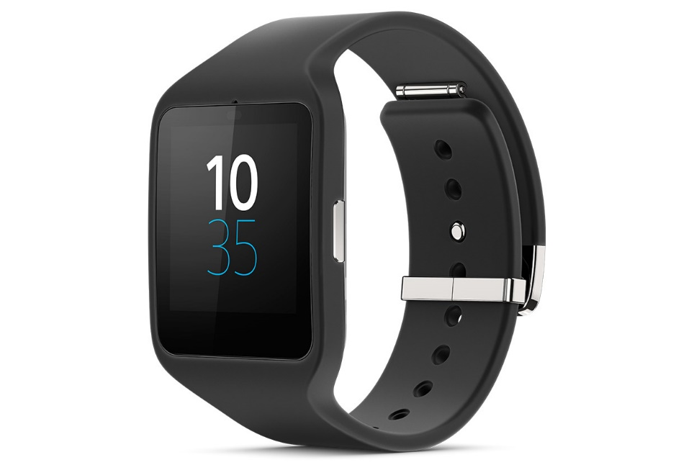
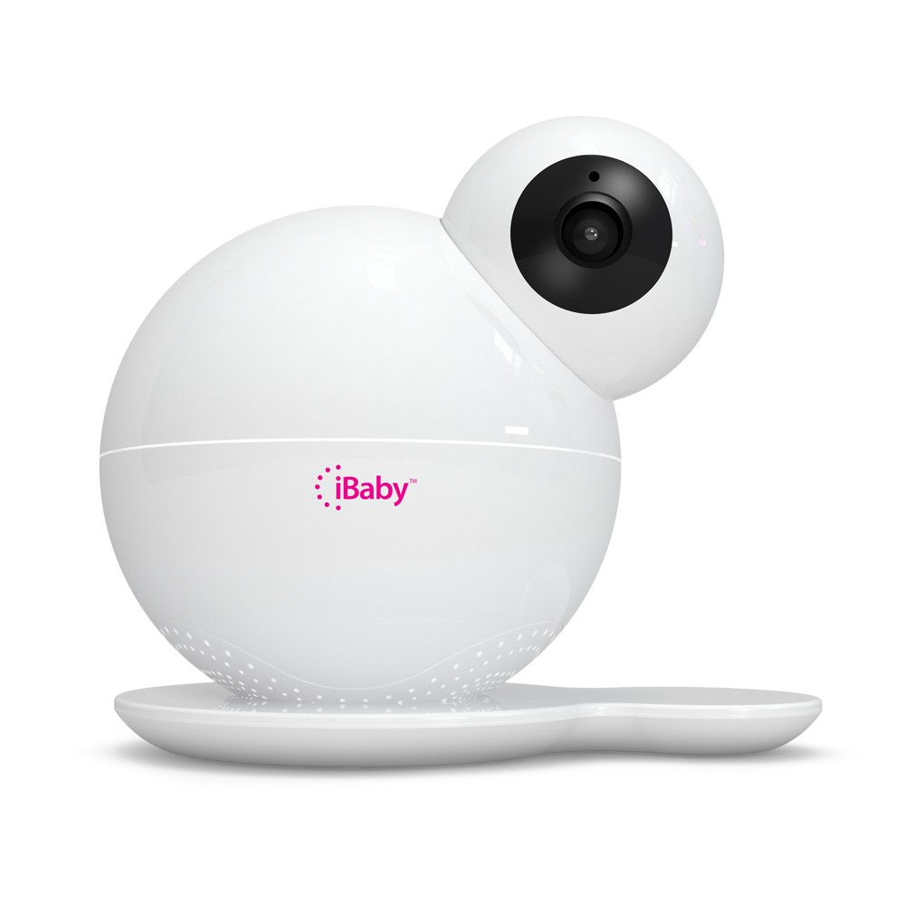
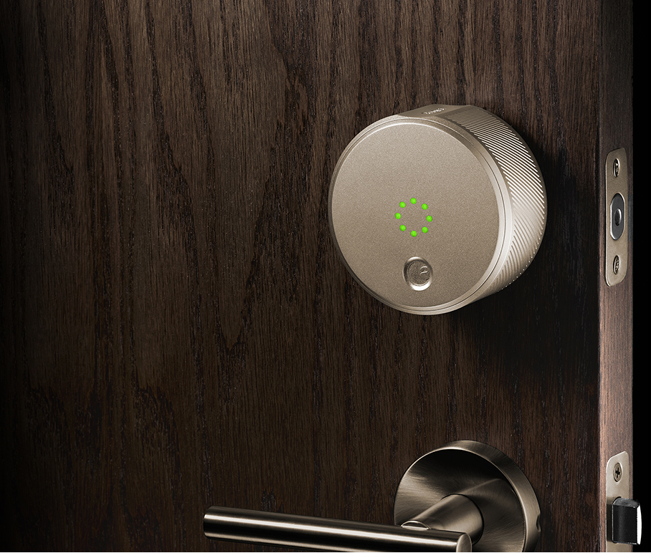
Consumer IoT examples
Personal productivity & fashion
Smartphones, smartwatches …
Home Automation
Smart locks, Bulbs, Smart TVs, Baby monitors…
Source: https://42xaiz2iny9m45jqzf36ofk2-wpengine.netdna-ssl.com/wp-content/uploads/2014/08/Front.jpg
https://c.slashgear.com/wp-content/uploads/2011/12/NO-4.jpg
Notes:
https://42xaiz2iny9m45jqzf36ofk2-wpengine.netdna-ssl.com/wp-content/uploads/2014/08/Front.jpg
https://community.rapid7.com/community/infosec/blog/2015/09/02/iotsec-disclosure-10-new-vulns-for-several-video-baby-monitors
https://c.slashgear.com/wp-content/uploads/2011/12/NO-4.jpg

Slide 12
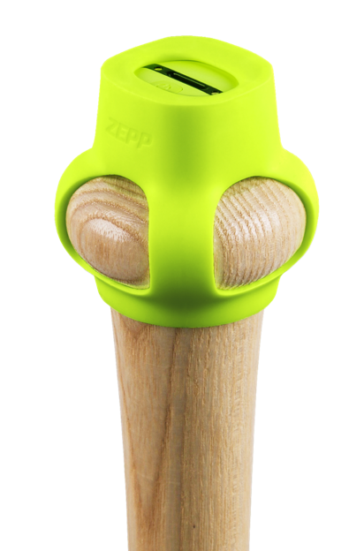
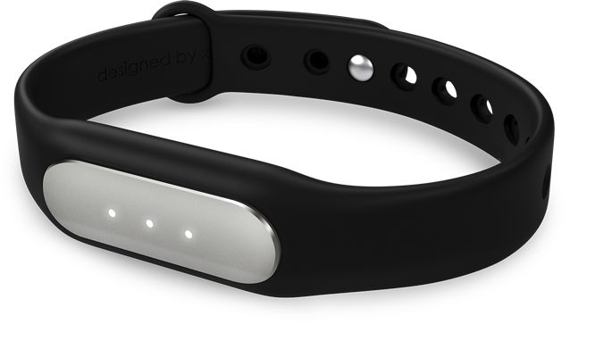
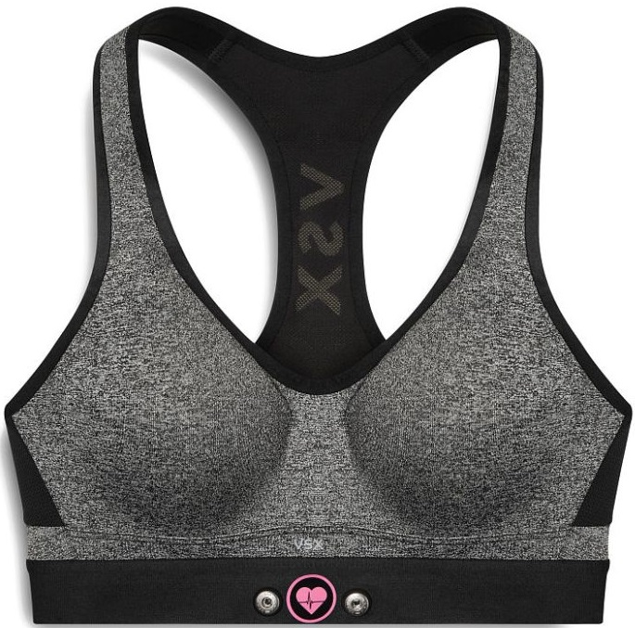
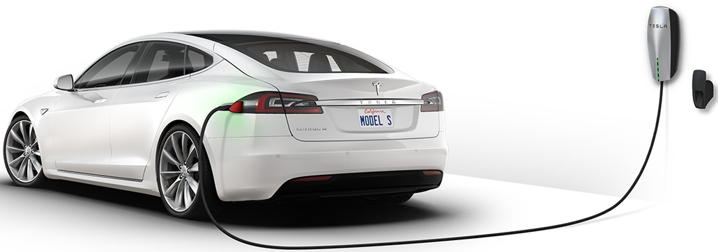
Consumer IoT examples contd.
Sports & Health
Fitness & health trackers
Professional sport gadgets
Connected cars …
Predictive maintenance, accident reaction, theft protection …
Source: https://tctechcrunch2011.files.wordpress.com/2014/11/victoria-secret-heart-rate-bra.jpg?w=738
https://cochlearimplanthelp.files.wordpress.com/2015/04/mi-band.jpg,
http://d3dc23s9xv125m.cloudfront.net/images/baseball/baseball_setup_connect@2x.pngTesla

Slide 13
What?
Notes:
https://gearjunkie.com/legacy/images/21010.jpg
https://tctechcrunch2011.files.wordpress.com/2014/11/victoria-secret-heart-rate-bra.jpg?w=738
https://cochlearimplanthelp.files.wordpress.com/2015/04/mi-band.jpg

Slide 14
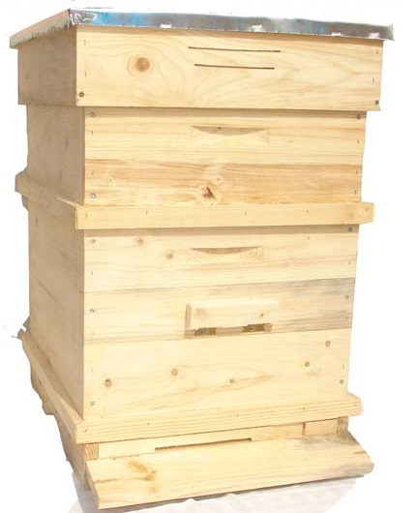
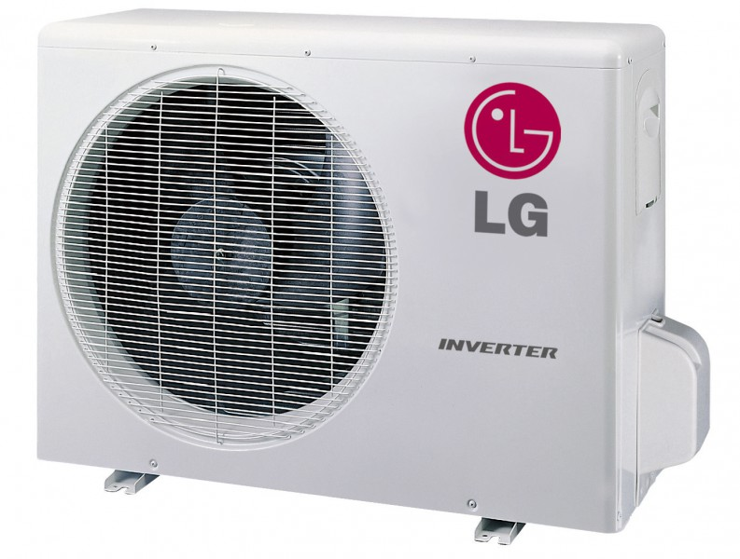
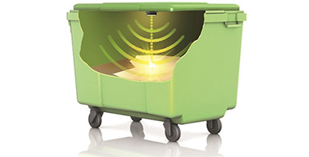
Course assignment
Objectives
Challenge yourself. No idea is too brave!
Try to make something useful
Learn new things
Examples
Smart beehive, A/C monitoring
Smart home / company / city
You name it …☺
?
Source: https://www.smartbin.com/markets/level-sensor-general-waste-recyclables/, LG air conditioners
Notes:
https://www.smartbin.com/markets/level-sensor-general-waste-recyclables/

Slide 15
How?
Notes:
https://gearjunkie.com/legacy/images/21010.jpg
https://tctechcrunch2011.files.wordpress.com/2014/11/victoria-secret-heart-rate-bra.jpg?w=738
https://cochlearimplanthelp.files.wordpress.com/2015/04/mi-band.jpg

Slide 16






IoT development platforms
Android & iOS
Phones, wearables, TVs …
Linux
Raspberry PI, Beaglebone …
RTOS
FreeRTOS, Nucleus …
Bare metal
Vendor SDKs: Espressif, NXP, TI, Atmel, Microchip …
Arduino: Atmel, ESP8266 (we will use this one)
Notes:
http://energia.nu/

Slide 17
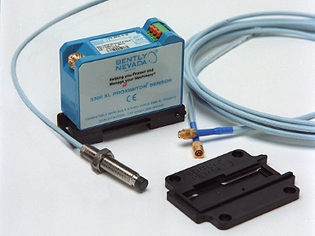
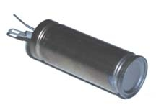
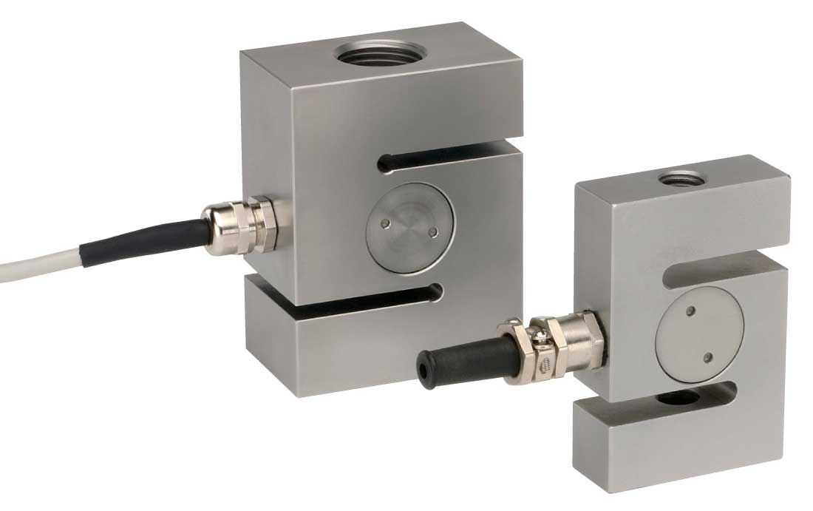
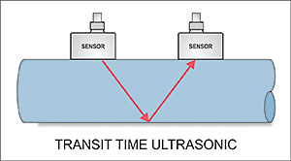
Sensors
So many sensors …
Touch, movement, compass, acceleration, video, sound
Temperature, humidity/moisture, light / infrared
Pressure, gas detection,
Force (tenso), proximity, motion
Liquid level, flow, magnetic field (hall), radiation
Fingerpring, heart rate …
Source: http://www.imagesco.com/geiger/buying-a-geiger-counter-pg3.html, http://www.greyline.com/twotechnologies.htm, http://www.noshok.com/force_2351_series.shtml
Notes:
http://www.imagesco.com/geiger/buying-a-geiger-counter-pg3.html
http://www.greyline.com/twotechnologies.htm
http://www.noshok.com/force_2351_series.shtml

Slide 18
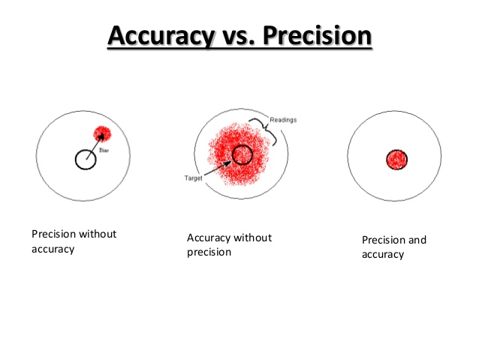
Sensors characteristics
Functional
Range
Accuracy
Precision (repeatability, noise)
Resolution & Sensitivity
Speed
Non-functional
Longevity & Reliability (MTBF, triplication)
Power consumption
Price
Op. environment: combustive, corrosive, military
Source: https://www.slideshare.net/akashmaurya24/shashank-soni-sensors-presentation
Notes:
http://kb.mccdaq.com/KnowledgebaseArticle50043.aspx
https://www.slideshare.net/akashmaurya24/shashank-soni-sensors-presentation
http://www.ni.com/white-paper/14860/en/

Slide 19

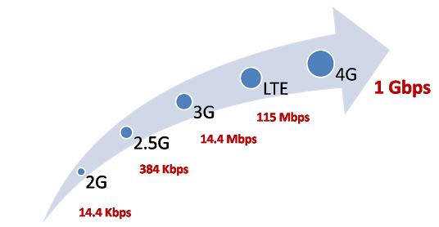



Connectivity (media access)
Long range
LoRaWAN, Sigfox, 6LoWPAN (868MHz), 3G/GPRS
Medium range
ZigBee, WiFi
Short range
Bluetooth 4.0/BLE, NFC/RFiD
Wired
Ethernet, RS-485, 4-20 mA …
Source: http://hitlistsofts.blogspot.bg/2015/05/difference-between-gsm-gprs-edge-3g.html
Notes:
http://www.libelium.com/products/waspmote/
http://hitlistsofts.blogspot.bg/2015/05/difference-between-gsm-gprs-edge-3g.html

Slide 20


Connectivity (application)
HTTP (REST)
CoAP
Stripped down, datagram based HTTP over UDP/SMS …
Goal: Interop with the web
MQTT
Open standard, Client/server (broker), pub/sub
SSL/TLS, user/pass auth
Many others: IRC, XMPP, AMQP …
CoAP

Slide 21



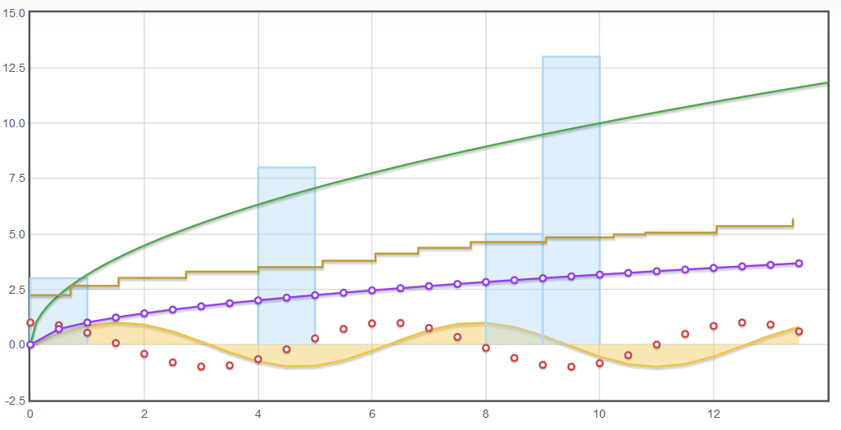
Data management and analytics
Data ingestion
Edge processing, batching & compression
Data ingestion: Kafka, HDFS, Cassandra …
Analytics
Spark/Hadoop, Python
Keras, Theano, TensorFlow …
Visualization
Matplotlib
D3 + plugins (e.g. c3js)
Dygraphs, Flot

Slide 22

Security
http://1.bp.blogspot.com/-1EN9zxdS6PQ/UKJSChMxu9I/AAAAAAAABEk/wheTrU34TBU/s640/I+am+Hacker.jpg
Notes:
http://1.bp.blogspot.com/-1EN9zxdS6PQ/UKJSChMxu9I/AAAAAAAABEk/wheTrU34TBU/s640/I+am+Hacker.jpg
http://www.prophethacker.com/wp-content/uploads/2016/04/Hacker-silhouette.jpg

Slide 23
Who’s the hacker?
Motivation
Emotion
Profit
Scientific interest
Black hats vs White hats
Damage
Money flow
Breaking the law?
Cyber war
Invested resources
Governments espionage
Industrial espionage
Security researchers
Competitors
Spammers
Wannabes
Expected profit

Slide 24
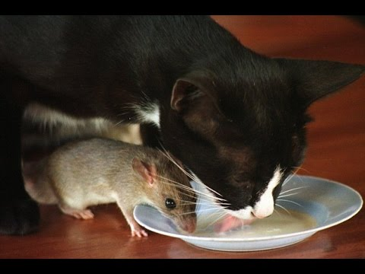
Solution?
No silver bullet
Balance between risks and profits
Learn from the others’ mistakes
Plan countermeasures
Source: https://www.youtube.com/watch?v=WyM2r-ixDvg

Slide 25
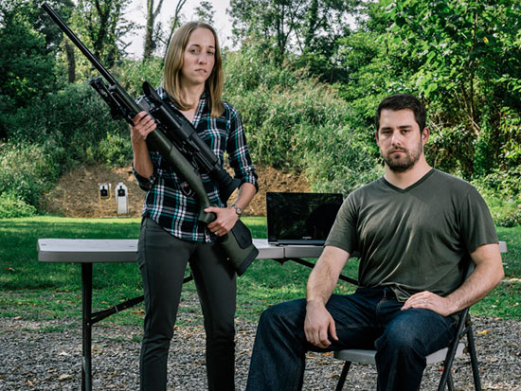
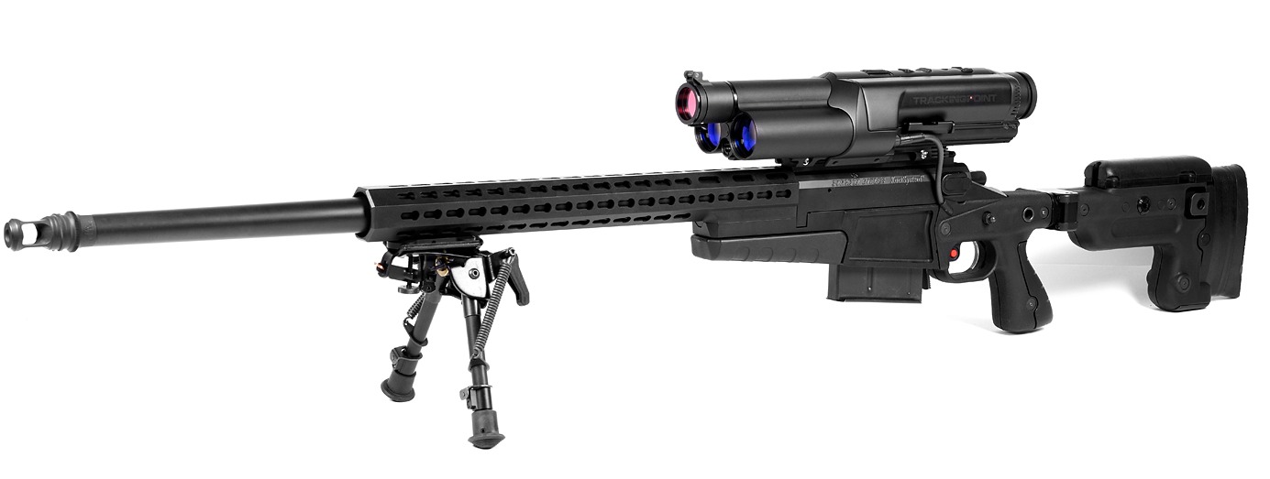
Showcase: Self aiming, social rifle …
Hackers: Runa Sandvik & Michael Auger
Target: 2013 TrackingPoint TP750 WiFi rifle
Payload:
Detune scope (e.g shoot wrong target)
DoS the entire scope
Source: http://adrenaline.uol.com.br/files/upload/noticias/2015/07/mateus/sniper-pc_2.jpg
Notes:
https://www.blackhat.com/docs/us-15/materials/us-15-Sandvik-When-IoT-Attacks-Hacking-A-Linux-Powered-Rifle.pdf
https://www.youtube.com/watch?v=ZcukSF7ruZY

Slide 26
Hacks
WiFi hotspot
WPA2 key is guessable and can’t be changed
Mobile API (tune ammo weight etc. )
“Secret” admin commands, one of which opens the SSH port
Raw backend access
Tune ammo weight without validation (persistently and without validation)
Firmware updates
GPG signed, but private key is on the device
Notes:
SSID contains serial number

Slide 27
Vendor’s official response
You can continue to use WiFi if you are confident no hackers are within 100 feet.

Slide 28
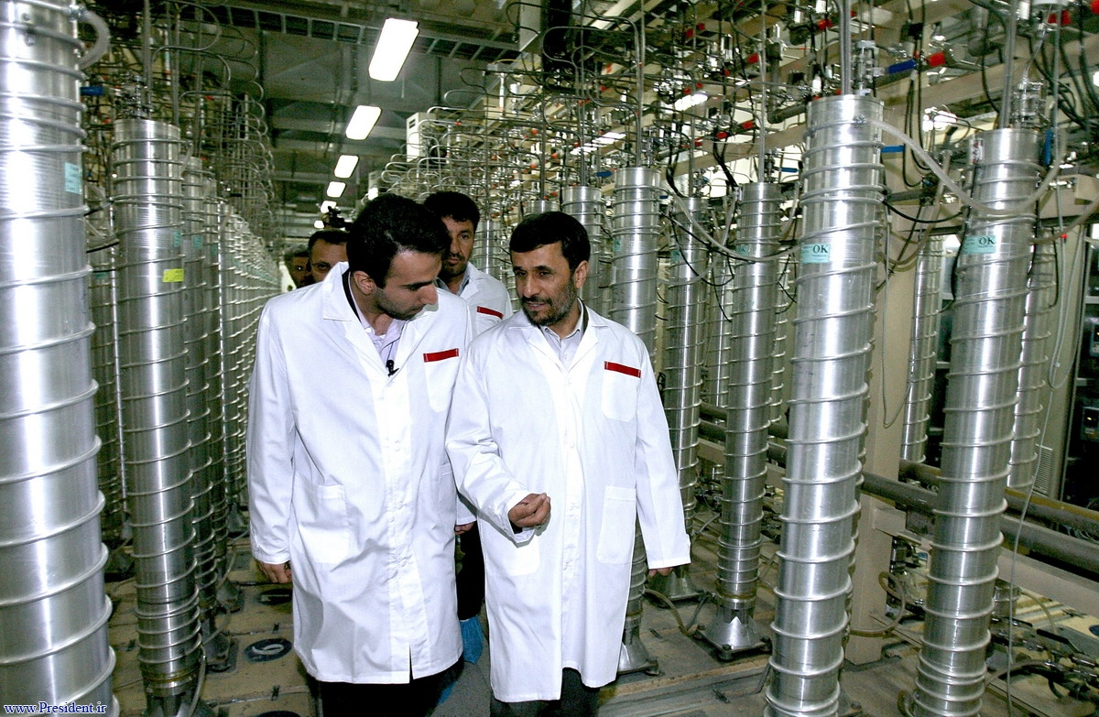
Stuxnet … an APT
Hackers: No Such Agency
Target: Iran’s Natanz uranium enrichment centrifuges
Attack: Spin rate could be controlled. Monitoring data tampered.

Slide 29
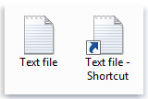
Hack details - infection
Windows shortcuts can reference an icon in a DLL
Windows uses LoadLibrary to load the icon from DLL
Result: malicious DLL executed with local user’s privileges
DLL file with icons
Notes:
11:30
Note: you don’t have to click the shortcut, but merely put the flash drive and it would even load DLLs from the internet using WebDAV).
Fix2 was to move from CRC32 to SHA256
https://www.youtube.com/watch?v=SD1J8LrkQJE
http://superuser.com/questions/335685/bizarre-shortcut-icon-problem-with-xp-7-dual-boot
https://chrlvclaudiu.wordpress.com/2010/08/19/exploit-microsoft-windows-automatic-lnk-shortcut-file-code-execution/
http://cve.mitre.org/cgi-bin/cvename.cgi?name=CVE-2010-2568
https://technet.microsoft.com/en-us/library/security/ms15-020.aspx
http://stackoverflow.com/questions/1515914/crc32-collision

Slide 30
Hack details – privilege escalation
Windows Vista+
Scheduled tasks are stored in XML files that are read/writeable by user
Task’s target user account is specified in the file
Files are CRC32 checksum validated before execution (sum stored in registry)
Windows XP
Keyboard layouts can be installed from any location (not just %SYSTEM%)
They contain an unvalidated function pointer index that the kernel trusts
Manipulating the index makes the kernel run code located in user space

Slide 31
Hack details – spread
All Windows versions
Copy to remote shares, USB drives etc.
Windows XP
A remote “Print to file” using a Guest account is possible
New MOF files in System32\wbem\MOF are compiled and executed under system privileges.
Notes:
http://poppopret.blogspot.com/2011/09/playing-with-mof-files-on-windows-for.html

Slide 32
Hack details – payload
Target
Siemens Simatic 6ES7-315-2 PLCs
Natanz specific configuration (cascade size >155, frequency > 1000Hz)
Result: no collateral damage in other plants
Payload
Increase spin rate from 1000 to 1410Hz for 15 min. Then sleep 27 days.
Decrease the spin rate to 5Hz for 50 min. Sleep another 27 days.
Report normal readings to the plant monitoring system
Result: ~1000 (out of ~16000) rotors cracked in a just a few months
Notes:
17:40
http://www.thetower.org/2545-iran-stops-dismantling-centrifuges-at-two-uranium-enrichment-plants/
(out of ~19000)
https://www.youtube.com/watch?v=wapd1-E5dzc

Slide 33
IoT specific security concerns
Doom’s day scenarios
e.g. Natanz
Privacy attacks
Samsung TV, Amazon Echo
IoT botnets
Devices turn to DDoS zombies (Mirai botnet -> 100K nodes)
Business risk & disruption
Bricked devices
Limited ability to update crypto (due to e.g. vendor, power, computing)
Wider the security perimeter

Slide 34


Possible security counter measures
Before the fact: Make attacker’s life harder
Strong crypto, SSO, 2FA
OWASP Internet of Things
Pentest hardware too (Logic analyzers, SDR …)
After the fact: Plan for mitigation
Technical (DDoS protection, device blacklisting, recall and factory reset)
PR & Legal (Ready made responses, limitation of liability)
Financial (Insurance, indemnification from partners)
Notes:
http://www.grandideastudio.com/wp-content/uploads/secure_embed_paper.pdf

Slide 35


Device management
Problems being solved
Secure device onboarding & off-boarding / blacklisting
Maintenance:
OTA updates, restarts
Diagnostics: uptime/heartbeat, network quality (latency, error rate)
Locating a device
Bulk operations scheduling & maintenance plans …
Solutions
OpenHAB, Kura
Blynk, Thingspeak, Beebotte, SAP, IBM …
And probably lots of home grown stuff due to specifics of business

Slide 36
Thank you
Contact information:
Pavel Genevski
Researcher / Architect
SAP Labs Bulgaria

Slide 39
The Grid
Headline area
White space
Drawing area

